Slide 1
Writing performant C#

Slide 2




Who is Jerry?
Active in IT since 2006
Technical Consultant .NET Solutions @ Inetum-Realdolmen
Technical Lead DevOps-Team Zanzibar since June 2019
Has a serious need for speed
jerry.vanechelpoel@inetum-realdolmen.world
@qlurichaun
www.linkedin.com/in/jerryvanechelpoel

Slide 3

Why this session?
Personal experience
Small losses on performance add up in the long run
Small fixes sometimes make a huge impact
Not so difficult to create performant applications, it’s a matter of knowledge

Slide 4
Today’s menu
01
02
What is performance?
The .NET CLR
03
04
Tools
Improving your code

Slide 5
What is performance?
01

Slide 6

What is performance?
Time to execute
Resources being used
Effort to change
➔ Cost effective

Slide 7
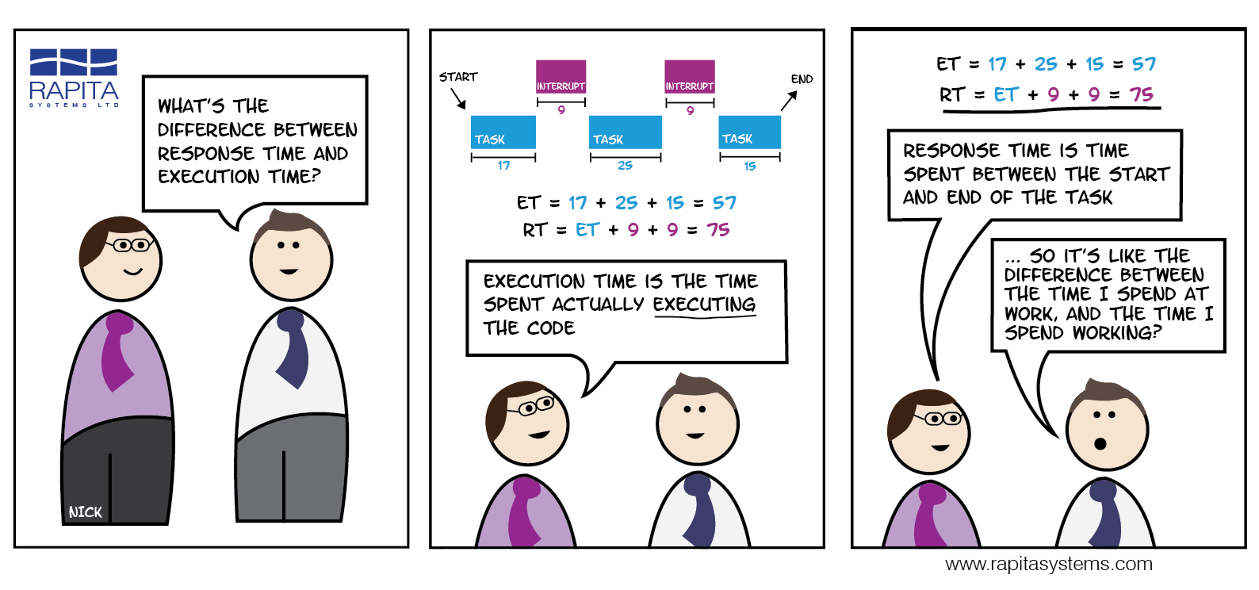
Execution time
Impacts user experience
Impacts cost of business
Impacts cost of infrastructure
Cloud but also on-premises infrastructure

Slide 8

Resources being used
Impacts cost of the infrastructure
Impacts other software
Deadlocks
Memory swapping
Bottlenecks

Slide 9
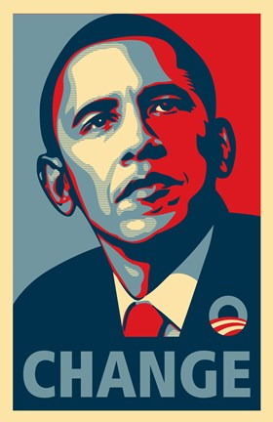
Effort to change
Clean code isn’t necessary performant code
Trade off: maintainable and testable code ⬄ performant code

Slide 10

When to fix performance?
User complains
Dependent systems are timing out
Cloud costs are higher than expected

Slide 11
The CLR
02

Slide 12
The CLR: your best friend
Common Language Runtime
Provides various services such as
Memory management
Performance improvements
Support for explicit free threading (allows scalable, multithreaded applications)

Slide 13
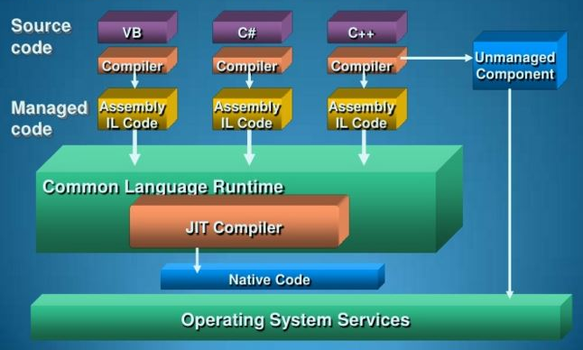
The CLR execution model

Slide 14
Why is knowledge on the CLR so important?
It allows you to write code that optimizes the features in the CLR
It makes you understand why something runs fast or slow
Things to consider
CLR cache
JIT-compilation
Memory allocations
Code optimizations

Slide 15
Tools
03

Slide 16

StopWatch
Part of System.Diagnostics namespace
Measures elapsed time
Start()
Stop()
Elapsed, ElapsedMilliseconds or ElapsedTicks
Reset(), Restart()
Stopwatch Class (System.Diagnostics) | Microsoft Docs

Slide 17

Logs
Works on every environment
Simple but effective and reliable
Be careful with averages
Misleading → doesn’t take into account the full picture
➔ Use percentiles

Slide 18

ILSpy
Opensource decompiler
Helps you understand what the CLR does to your code
Decompilation support in VS 2022 through F12
GitHub - icsharpcode/ILSpy: .NET Decompiler

Slide 19

BenchmarkDotNet
Library for benchmarking
Used for optimizing code
Can be applied in CI as part of a unit test
Provides user friendly reports
BenchmarkDotNet

Slide 20
dotnet-counters
ad-hoc health monitoring and first-level performance investigation
dotnet-counters diagnostic tool - .NET CLI (Microsoft Docs)

Slide 21
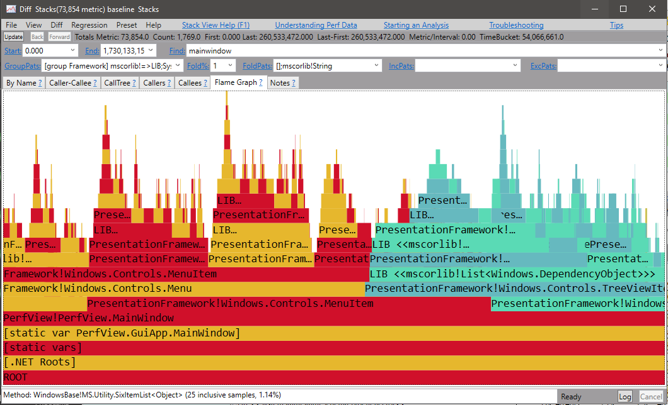
PerfView
Open-source performance-analysis tool
Customizable to your needs
Not an easy tool
Provides
Performance profiling
Memory profiling
Diagnostics reports
PerfView (github.com)

Slide 22

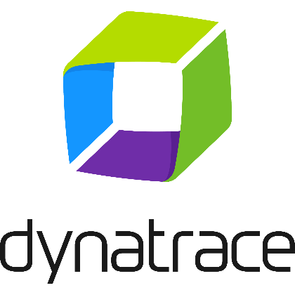



APMs
Application Performance Monitor tools
Lean agents that
Collect Event Tracing logs of the .NET process
Attach profiler to .NET process to access .NET profiling API
Azure App Insights
Dynatrace
Datadog
Stackify
Raygun

Slide 23
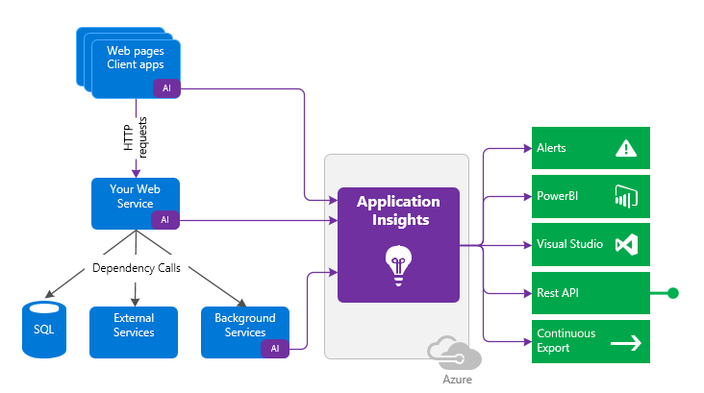
Azure App Insights
Feature of Azure Monitor
Detects performance anomalies automatically
Helps diagnosing issues with analytical tools
Kusto Query Language (KQL)

Slide 24
Improving your code
04

Slide 25
Using appropriate type

Slide 26
Variables
sbyte, byte, short, ushort, int, uint, long, ulong → integral values
int is preferred → optimal use of memory
Float
graphical values
32 bits
Double
scientific values
64 bits
Decimal
Financial values
128 bits
Most accurate but also higher footprint

Slide 27
Interface vs. Concrete type
Concrete type
Best choice for implementation → closest to functionality
Example: T[] → a collection that is fixed in length
Interface
Expresses an intention
Example: IEnumerable<T> = The intention to loop
Requires the runtime to find out the exact implementation
Usage
Dependency Injection (to support unit tests)
Return values (LINQ)

Slide 28
Collections
Use Array.Empty<T>() instead of new T[0]
Runtime caches the empty array objects → reduced memory footprint
Create collection with capacity
Avoids extending the underlying array
Use T[] over IEnumerable<T> and List<T> when possible
Arrays are the fastest to iterate

Slide 29
LINQ
Extension methods on IEnumerable<T>
Every LINQ-to-Object-call initiates a loop
Count/Length vs. Count()/Any()
Count/Length: property = fast access
Count()/Any(): method = potential slow
Check if something exists and then retrieve the value
Use FirstOrDefault() and use null check instead of Any() and FirstOrDefault()

Slide 30
Using strings

Slide 31
String comparison
Don’t use ToUpper() or ToLower()
Causes new strings to be created
Equals, Contains, IndexOf, …
Provide StringComparison parameter
StringComparison enum
Most performant: StringComparison.OrdinalIgnoreCase
Linguistic relevance: StringComparison.InvariantCultureIgnoreCase
Full documentation: Best Practices for Comparing Strings in .NET | Microsoft Docs

Slide 32
String manipulations
Roads to string manipulation
String concatenation
String interpolation
StringBuilder
String.Format
Single manipulation: string interpolation is most effective in most cases
Readable and almost no difference in speed with concatenation
$"{value1} : {value2}" is translated as value1 + " : " + value2
String.Format least efficient
Uses StringBuilder
Performs validation on parameters

Slide 33
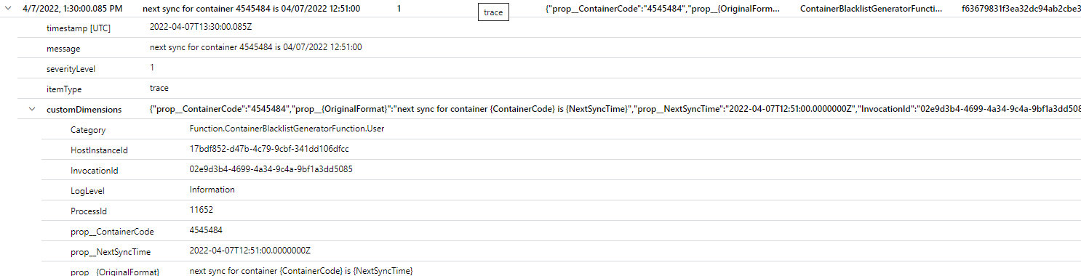
Logging
! Don’t use string manipulation statements in logging statements !
Logging provides string manipulation, but only when logging is enabled
➔ avoids string manipulation when not required
Logging with placeholders provides extra context to logging facility such as Application Insights

Slide 34
Optimize classes and objects

Slide 35
Sealed classes
Runtime always looks for children of object
Make classes sealed to avoid this lookup
Business components are usually the end of an inheritance hierarchy
Be careful not to break testing capabilities

Slide 36
Properties
Auto-initalisation
Executed when property is used for the first time
Defers initialisation
Examples:
Lists that are declared as field or property, but are not always used
In-memory cache
Use static properties for “constant” objects
! Be aware of generic types !
Generic types are compiled to a concrete type
Static fields and properties are created for this concrete type ➔ static field/property created for each concrete type
Use “Store” objects to avoid this

Slide 37
Methods: Length
Keep as short as possible
Max. 40 lines
Limit cyclomatic complexity as much as possible
Increases maintainability and testability
Caching is easier for the runtime when cyclomatic complexity is low.

Slide 38
Methods: Parameters
Maximum amount of parameters: 4
Runtime uses tuples when there are more than 4 parameters → More hits on memory to fetch tuple value
Example: void DoSomething(int param1, decimal param2, string param3, double p4, int p5) is handled in memory as void DoSomething(int param1, decimal param2, string param3, (double p4, int p5) param4)
Reduces the responsbilities of a method
Use a DTO when more parameters are required

Slide 39
Methods: Static
No access to object state → static
Creates only a single pointer in memory for the method

Slide 40
JSON

Slide 41
JSON serialization
Use System.Text.Json instead of NewtonSoft.Json
More focus on
Performance
Security
Standard compliance
More or less halfs serialization time (depending on settings)

Slide 42
Consuming JSON
Use StreamContent instead of StringContent
Serialize content straight on stream instead of serializing to string and then creating StringContent
Reduces memory and performance footprint

Slide 43
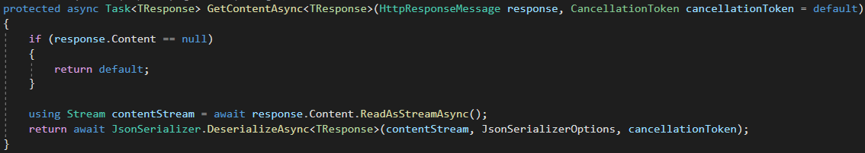
Getting content from stream

Slide 44
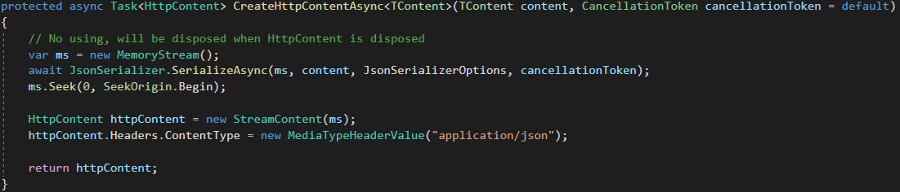
Sending content through stream

Slide 45
EF Core

Slide 46
Avoid roundtrips
DbContext is a “slow” resource
Database access = disk access
IO is always considered slow
Bulk processes:
Prefetch data as much as possible
Execute SaveChanges as late as possible

Slide 47
Wrapping DbContext in a repository
Just don’t ☺
DbContext implements the repository pattern
Use SQLite to support unit tests
Query limitations: not all types are supported
DateTimeOffset (use DateTime as possible alternative, but requires manual UTC conversion)
Decimal (use double with value convertor as alternative)
TimeSpan
UInt64

Slide 48
Projections
Project entities straight into DTO
Retrieve only properties you need
Disables change tracking
Reduces mapping overhead
Implicit include

Slide 49
Raw SQL
To avoid inefficient LINQ-queries
Can be combined with LINQ (where, orderby, include, …)
Filtering on large sets of data
Use JOIN instead of IN through OPENJSON (SQL Server)
! Remarks!
Database dependent
Unit testing becomes impossible → can be covered by integration tests
All properties of the mapped entity should be present in resultset
Related data cannot be included in the query

Slide 50
Bulk & batch updates
Batch updates
2 roundtrips
Fetch data
Persist changes in multiple statements (42 by default, configurable through startup)
Supported through change tracking and SaveChanges
Bulk updates
2 roundtrips
Fetch data
Persist changes in one statement
Supported through Raw SQL

Slide 51
